Slide 1
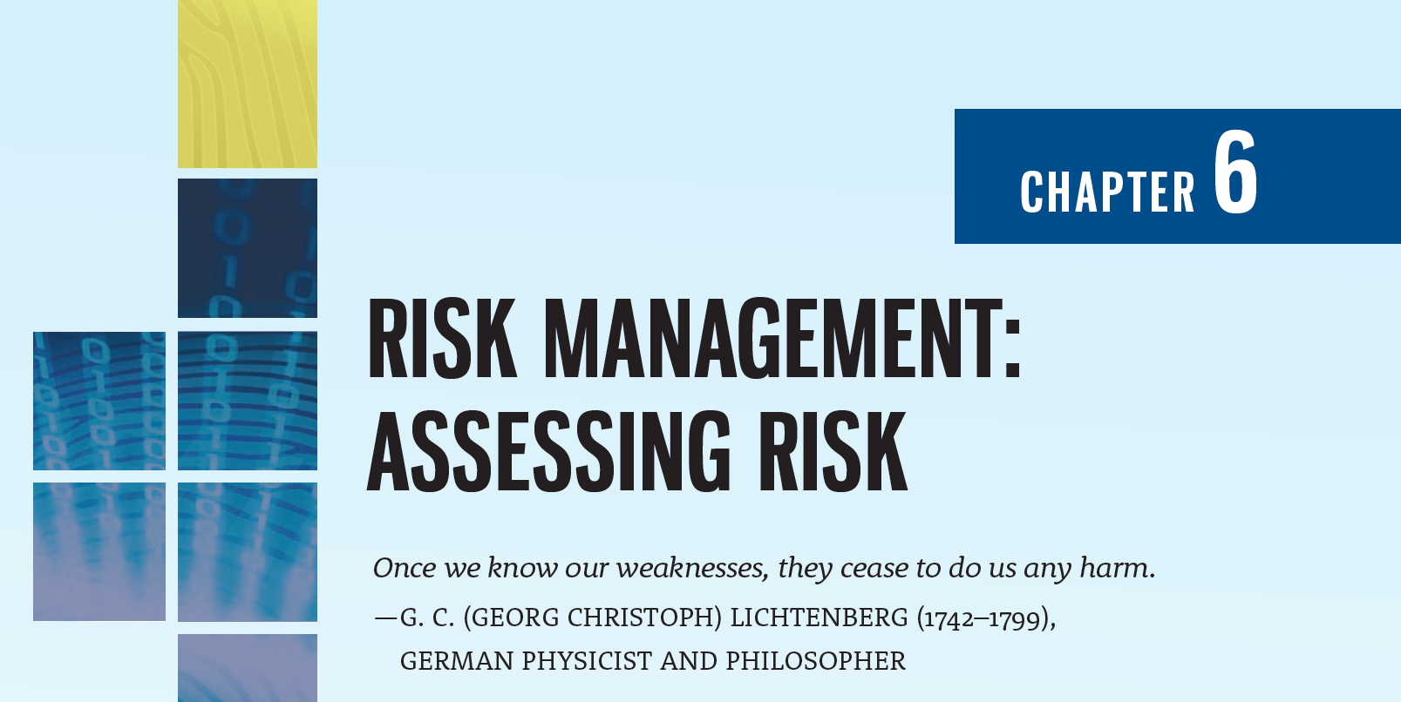

Slide 2
Learning Objectives
Upon completion of this chapter, you should be able to:
Define risk management and its role in the organization
Describe risk management techniques to identify and prioritize risk factors for information assets
Explain how risk is assessed based on the likelihood of adverse events and the effects on information assets when events occur
Discuss the use of the results of the risk identification process

Slide 3
Introduction to the Management of Risk in Information Security
Chapter 06: Risk Management: Assessing Risk

Slide 4
Risk Management
Therefore I say: One who knows the enemy and knows himself will not be in danger in a hundred battles
One who does not know the enemy but knows himself will sometimes win, sometimes lose
One who does not know the enemy and does not know himself will be in danger in every battle
Sun Tzu

Slide 5
Introduction
InfoSec managers and technicians are the defenders of information
They constantly face a myriad of threats to the organization’s information assets
A layered defense is the foundation of any InfoSec program

Slide 6
Knowing Yourself and Knowing the Enemy
When operating any kind of organization, a certain amount of risk is always involved
For an organization to manage risk properly, managers should understand how information is collected, processed, stored, and transmitted
Knowing yourself in this context requires identifying which information assets are valuable to the organization, categorizing and classifying those assets, and understanding how they are currently being protected
Knowing the enemy means identifying, examining, and understanding the threats facing the organization’s information assets

Slide 7
The Information Security Risk Management Framework
Risk management is the process of discovering and assessing the risks to an organization’s operations and determining how those risks can be controlled or mitigated
This process involves discovering and understanding answers to some key questions with regard to the risk associated with an organization’s information assets:
Where and what is the risk (risk identification)?
How severe is the current level of risk (risk analysis)?
Is the current level of risk acceptable (risk evaluation)?
What do I need to do to bring the risk to an acceptable level (risk treatment)?

Slide 8
The Information Security Risk Management Framework (Continued)
Risk management is a complex operation that requires a formal methodology; this approach to RM involves two key areas: the RM framework and the RM process
The RM framework is the overall structure of the strategic planning and design for the entirety of the organization’s RM efforts
The RM process is the implementation of risk management, as specified in the framework
The RM framework and the RM process are continuous improvement activities, which means they are ongoing, repetitive, and designed to continually assess current performance in order to improve future RM results

Slide 9
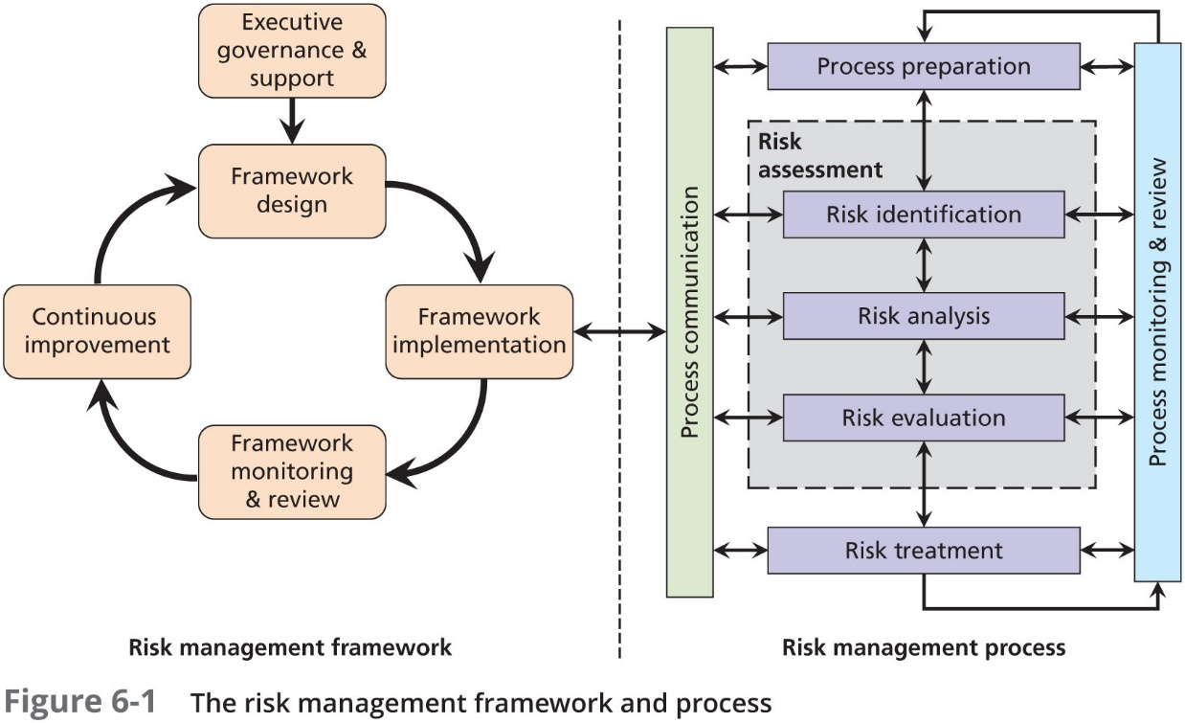

Slide 10
The Information Security Risk Management Framework (Continued)
The RM framework consists of five key stages:
Executive governance and support
Framework design
Framework implementation
Framework monitoring and review
Continuous improvement
This model is adapted to be in alignment with an ISO standard, while others are based on industry standards or proprietary models

Slide 11
Roles of Communities of Interest in Managing Risk
Each of the three communities of interest directly linked to managing the risks to information assets has a particular strategic role to play:
InfoSec—Because members of the InfoSec community best understand the threats and attacks that introduce risk, they often take a leadership role in addressing risk
IT—This group is responsible for building secure systems and ensuring their safe operation
General management and users—When properly trained and kept aware of the threats faced by the organization, this group plays a part in the early detection and response process. Members of this community also ensure that sufficient resources are allocated to the InfoSec and IT groups to meet the security needs of the organization

Slide 12
Executive Governance and Support
The entire RM program begins with a formal acknowledgement by the organization’s most senior governance group that RM is invaluable and critical to the organization’s long-term sustainability and viability
After acknowledging this, the group formally commissions the development and eventual implementation of the RM project
Prior to the actual design of the framework, the governance group must demonstrate its commitment to the RM effort by notifying the entire organization that:
a major RM project is underway,
the project is of the utmost importance to the strategic future of the organization, and
the participation and cooperation of all aspects of the organization are mandated and are crucial to the project’s success

Slide 13
Executive Governance and Support (Continued)
Additional tasks performed by the governance group during the framework design phase include:
Ensuring compliance with all legal and regulatory statutes and mandates
Guiding the development of, and formally approving, the RM policy
Recommending performance measures for the RM effort and ensuring that they are compatible with other performance measures in the organization
Assigning roles and responsibilities
Ensuring that the selected goals and objectives are appropriate and in alignment with the organization’s strategic goals and objectives
Providing needed resources

Slide 14
Legal and Regulatory Compliance
It is the governance group’s responsibility to ensure that the RM process is in complete compliance with all applicable requirements
This is commonly done by assigning a member of the organization’s legal team (when there is one) to the RM framework team, or by requiring that all work products from the team are reviewed and approved by the designated legal counsel

Slide 15
The RM Policy
For RM program development and implementation, the project leader, in cooperation with the governance group, drafts a risk management policy
While no two policies are identical, most RM policies include:
Purpose and scope
RM intent and objectives
Roles and responsibilities of subordinate groups
Resource requirements
Risk appetite and tolerances
RM program development guidelines
Special instructions and revision information
References to other key policies, plans, standards, and guidelines

Slide 16
Assigning Key Responsibilities
As the organization moves forward with RM development efforts, key responsibilities have to be specified by the governance group:
Who will be the project manager of the RM framework team?
Who will be assigned to the framework team?
Who will be assigned to the process team?
Who will manage each of these teams?
In most organizations, either the CIO, CISO, or their equivalent leads the RM effort
In many instances, the CIO serves as the champion and the CISO as the project manager

Slide 17
Assigning Key Responsibilities (Continued)
Like every other major organizational effort, all managers have a vested interest in the success of the RM process and should support it:
InfoSec management must lead the way with skill, professionalism, flexibility, and subject expertise because it works with the other communities of interest to coordinate the project so it reflects the need to balance the constant tradeoffs between the organization’s need to use information and its responsibility to protect it
IT management must appoint representatives who understand how IT supports the needs of the broader organization and how IT interacts with InfoSec with regard to the protection of information assets
General management must support the RM function by providing representatives who understand how the business areas of the organizations use information, how InfoSec is critical to the effective use of that information, and how those areas are impacted by the RM project

Slide 18
Developing Priorities and Objectives and Providing Resources
Once the members of the RM framework team have been identified, the governance group should communicate its intent, priorities, and desired outcomes for the overall RM program
The project leader will then translate this intent into a set of goals and objectives for the RM effort
Once a policy has been developed, or concurrently with development of that policy, the governance group must allocate the resources needed to support RM program development and implementation

Slide 19
Framework Design
In this stage, the framework team begins designing the RM process by which the organization will understand its current levels of risk and determine what, if anything, it needs to do to bring that level down to an acceptable level in alignment with the risk appetite specified earlier in the process
At this stage, the organization may select a methodology, or it may even decide to develop its own methodology
The framework team must also formally document and define the organization’s risk appetite and draft the RM plan

Slide 20
Defining the Organization’s Risk Tolerance and Risk Appetite
As the governance group communicates its intent to the RM framework development team, it also needs to communicate its general perspective on what level of risk is acceptable and what risk must be reduced or resolved in some fashion
The amount of risk that remains after all current controls are implemented is residual risk
The difficulty lies in the process of formalizing exactly what the organization “can live with,” which is its risk appetite

Slide 21
The Risk Management Plan
The document that contains specifications for the implementation and conduct of the RM efforts is referred to as the risk management plan
The RM plan includes not only the specifications of the RM process but also of the RM framework
Whereas the RM policy focuses on the “who and why” of RM, the plan is focused on the “who and how”

Slide 22
Framework Implementation
Once the framework team has finished designing the RM program (framework and process), it begins implementing the program
The RM process provides general steps to follow in the conduct of risk evaluation and remediation and is designed to be intentionally vague so it can be adapted to any one of the methodologies available

Slide 23
Framework Implementation (Continued)
The implementation of the RM plan, specifically including the RM process, could be based on a number of traditional IT implementation methods:
The organization may distribute the plan to all mid- to upper-level managers for a desk check prior to deployment
The organization could pilot test it in a small area to gauge initial issues and success prior to deployment across the entire organization
The organization may use a phased approach in which only a portion of the RM program is initially implemented, such as initial meetings with key managers or initial inventory of information assets
The bold organization may simply choose a direct cutover (also known as a cold turkey conversion) in which the new RM project is launched in totality across the entire organization

Slide 24
Framework Monitoring and Review
After the initial implementation and as the RM effort proceeds, the framework team continues to monitor the conduct of the RM process while simultaneously reviewing the utility and relative success of the framework planning function itself
The framework itself only exists as a methodology to design and implement the process, so once the framework is documented in the RM plan, the success of the process becomes the greatest concern
Once the RM process is implemented and operating, the framework team is primarily concerned with the monitoring and review of the overall RM process cycle

Slide 25
Continuous Improvement
Continuous improvement is the process of implementing a formal program designed to continuously review and improve any type of organizational effort
The difference between current outcomes and the ideal outcomes envisioned is commonly referred to as the gap; the assessment between the two is known as a gap analysis
The performance measures implemented in the RM process provide the data used to assess the performance outcome of the overall RM effort

Slide 26
The Risk Management Process
Chapter 06: Risk Management: Assessing Risk

Slide 27
The Risk Management Process
During the implementation phase of the RM framework, the RM plan guides the implementation of the RM process, in which risk evaluation and remediation of key assets are conducted
The RM process uses the specific knowledge and perspective of the team to complete the following tasks:
Establishing the context
Identifying risk
Analyzing risk
Evaluating the risk
Treating the unacceptable risk
Summarizing the findings

Slide 28
RM Process Preparation—Establishing the Context
The context in this phase is the understanding of the external and internal environments the RM team will be interacting with as it conducts the RM process
It also means understanding the RM process as defined by the framework team and having the internal knowledge and expertise to implement it
Finally, it means ensuring that all members of the RM process team understand the organization’s risk appetite statement and are able to use the risk appetite to translate that statement into the appropriate risk treatment when the time comes

Slide 29
Risk Assessment: Risk Identification
The first operational phase of the RM process is the identification of risk, which begins with the process of self-examination
At this stage, managers must:
identify the organization’s information assets,
classify them,
categorize them into useful groups, and
prioritize them by overall importance
The RM process team has to initially confirm or define the categories and classifications to be used for the information assets, once identified

Slide 30
Identification of Information Assets
The risk identification process begins with the identification and cataloging of information assets, including people, procedures, data, software, hardware, and networking elements
In the most general sense, an information asset is any asset that collects, stores, processes, or transmits information, or any collection, set, or database of information that is of value to the organization

Slide 31
Identification of Information Assets (Continued)
Some commercial RM applications simplify the decision by separating information assets from media, which in this context include hardware, integral operating systems, and utilities that collect, store, process, and transmit information, leaving only the data and applications designed to directly interface with the data as information assets for the purposes of RM
By separating components that are much easier to replace (hardware and operating systems) from the information assets that are in some cases almost irreplaceable, the RM effort becomes much more straightforward

Slide 32
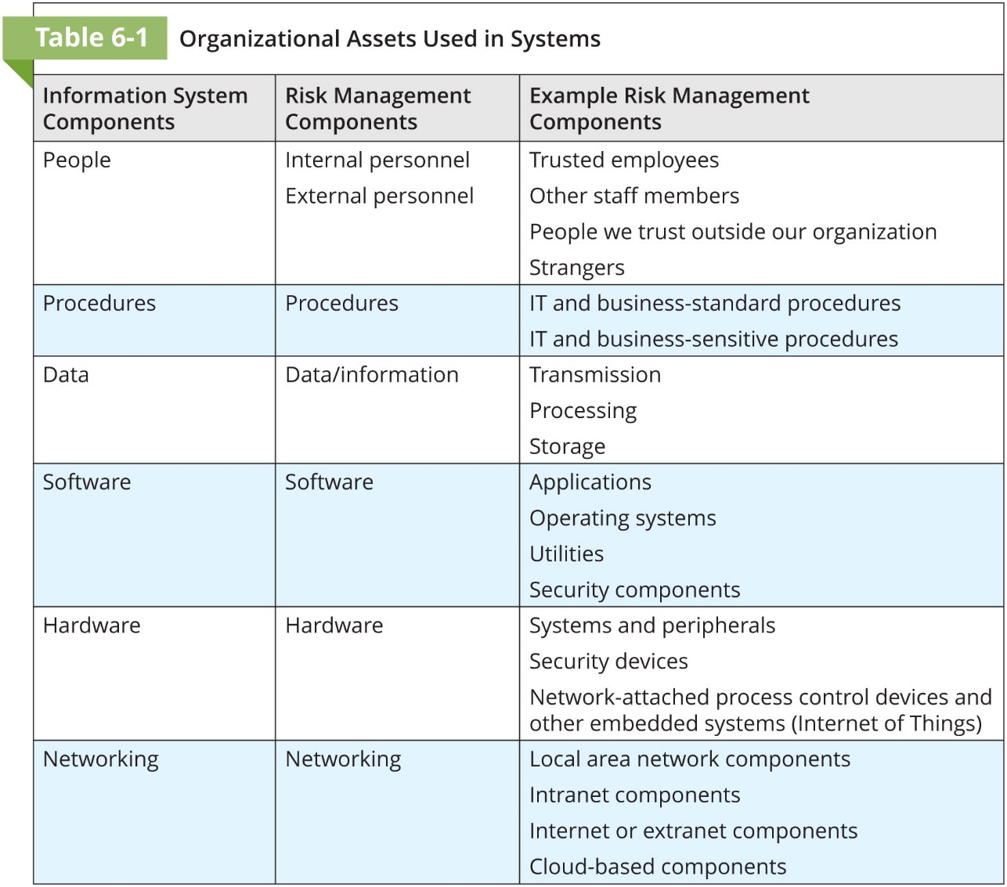

Slide 33
Identifying Hardware, Software, and Network Assets
Many organizations use asset inventory systems to keep track of their hardware, network, and software components
Whether automated or manual, the inventory process requires a certain amount of planning
Determine which attributes of each of these information assets should be tracked, which will depend on the needs of the organization and its risk management efforts

Slide 34
Identifying Hardware, Software, and Network Assets (Continued)
When deciding which attributes to track for each information asset, consider the following list of potential attributes:
Name
Asset tag
IP address
MAC address
Asset type
Serial number
Manufacturer name
Manufacturer’s model or part number
Software version, update revision, or FCO number
Physical location
Logical location
Controlling entity

Slide 35
Identifying People, Procedures, and Data Assets
Responsibility for identifying, describing, and evaluating these information assets should be assigned to managers who possess the necessary knowledge, experience, and judgment
As these assets are identified, they should be recorded via a reliable data-handling process like the one used for hardware and software

Slide 36
Identifying People, Procedures, and Data Assets (Continued)
People
Position name/number/ID
Supervisor name/number/ID
Security clearance level
Special skills
Procedures
Description
Intended purpose
Software/hardware/networking elements to which it is tied
Location where procedure documents are stored for reference
Location where documents are stored for update purposes
Data
Classification
Owner/creator/manager
Size of data structure
Data organization used
Online or offline
Physical Location
Media access method
Backup procedures

Slide 37
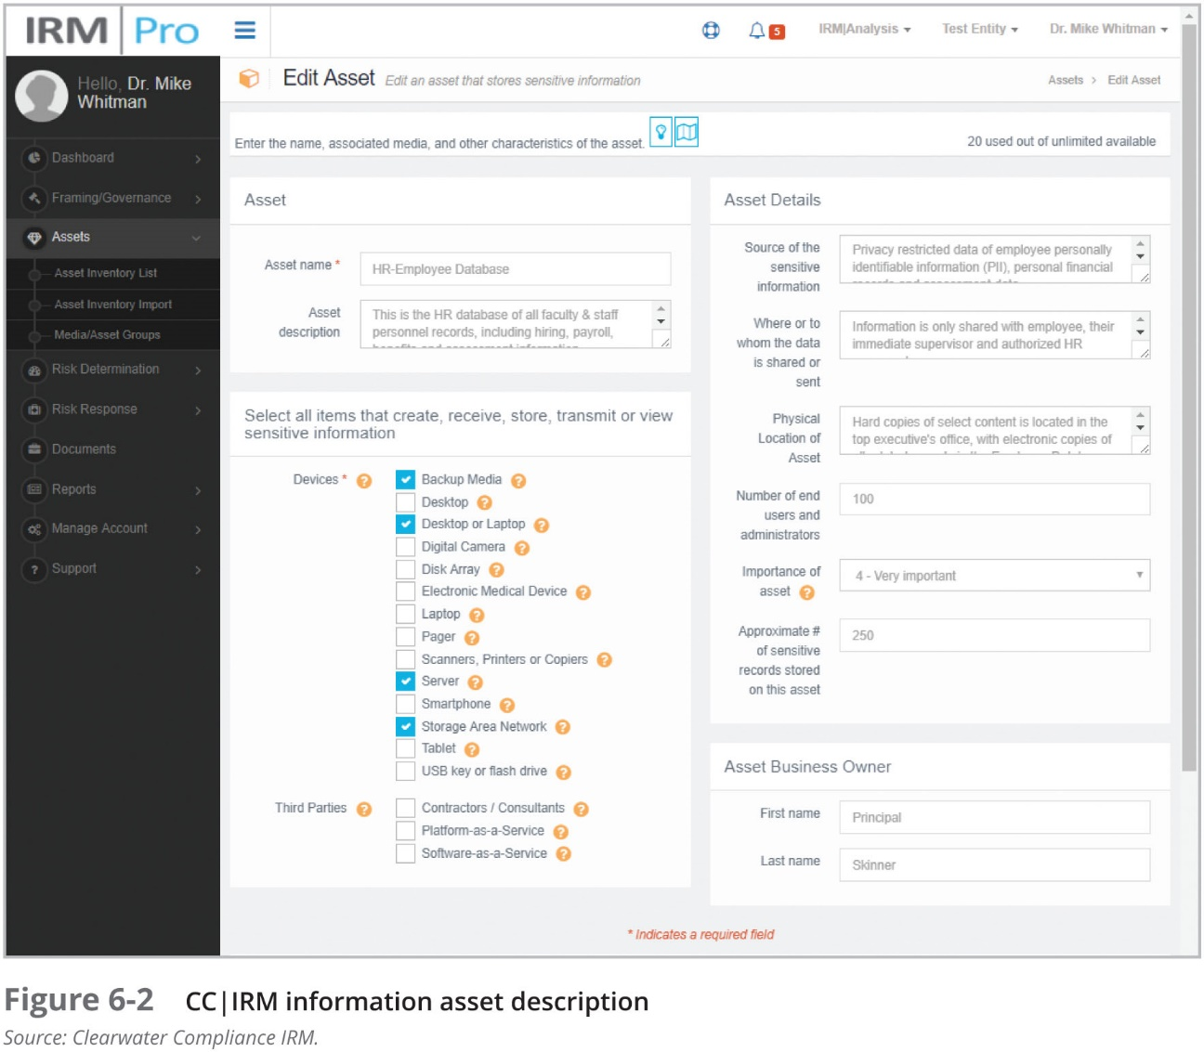

Slide 38
Classifying and Categorizing Information Assets
Once the initial inventory is assembled, determine whether its asset categories are meaningful to the RM program
Inventory should also reflect sensitivity and security priority assigned to each information asset
A data classification scheme should be developed that categorizes these information assets based on their sensitivity and security needs
Each of these categories designates the level of protection needed for a particular information asset
Classification categories must be comprehensive and mutually exclusive

Slide 39
Assessing Values in Information Assets
As each information asset is identified, categorized, and classified, a relative value must be assigned
Relative values are comparative judgments made to ensure that the most valuable information assets are given the highest priority, for example:
Which information asset is the most critical to the success of the organization?
Which information asset generates the most revenue?
Which information asset generates the highest profitability?
Which information asset is the most expensive to replace?
Which information asset is the most expensive to protect?
Which information asset’s loss or compromise would be the most embarrassing or cause the greatest liability?

Slide 40
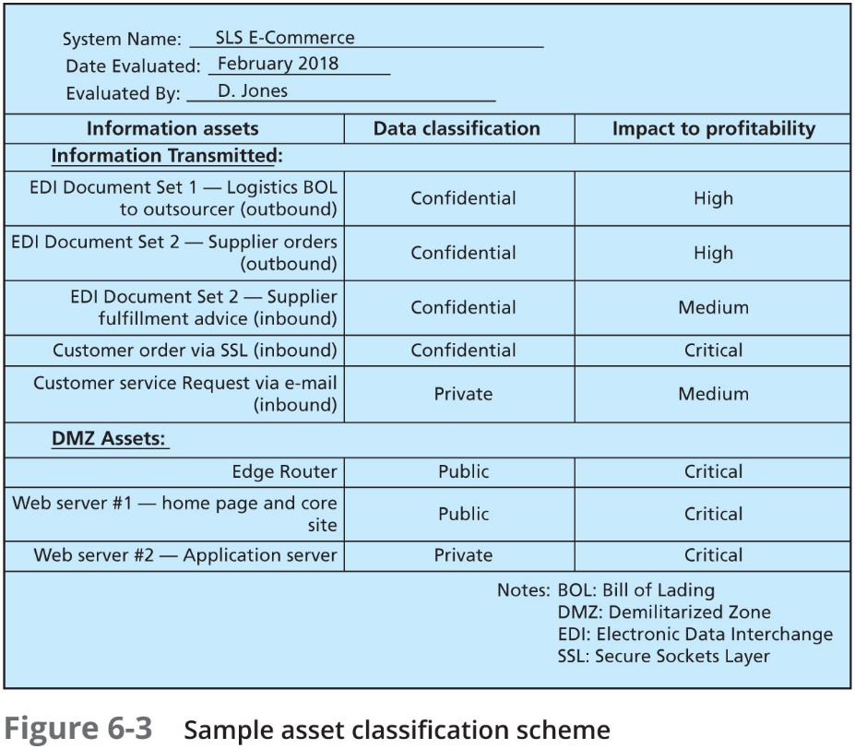

Slide 41
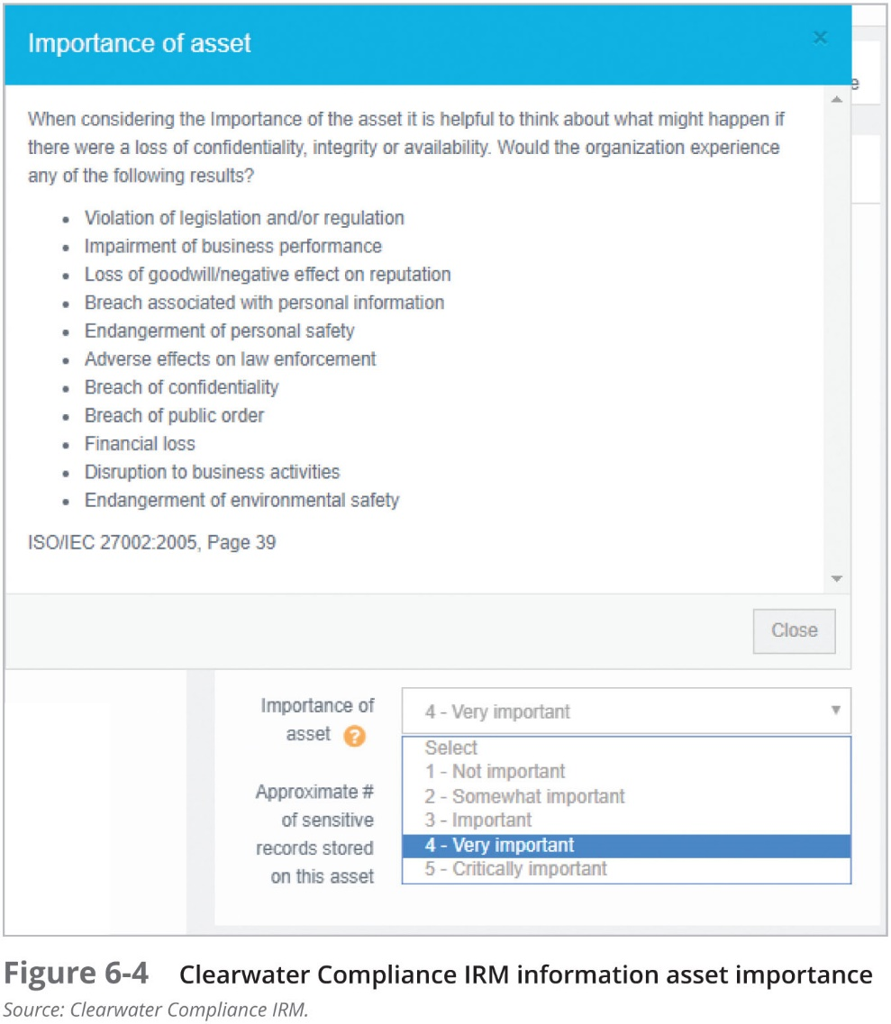

Slide 42
Prioritizing (Rank Ordering) Information Assets
The final step in the risk identification process is to prioritize, or rank order, the assets
This goal can be achieved by using a weighted table analysis
Such tables can be used as a method of valuing information assets by ranking various assets based on criteria specified by the organization
This method may prove to be much more straightforward than a raw estimation based on some other more ambiguous assessment

Slide 43
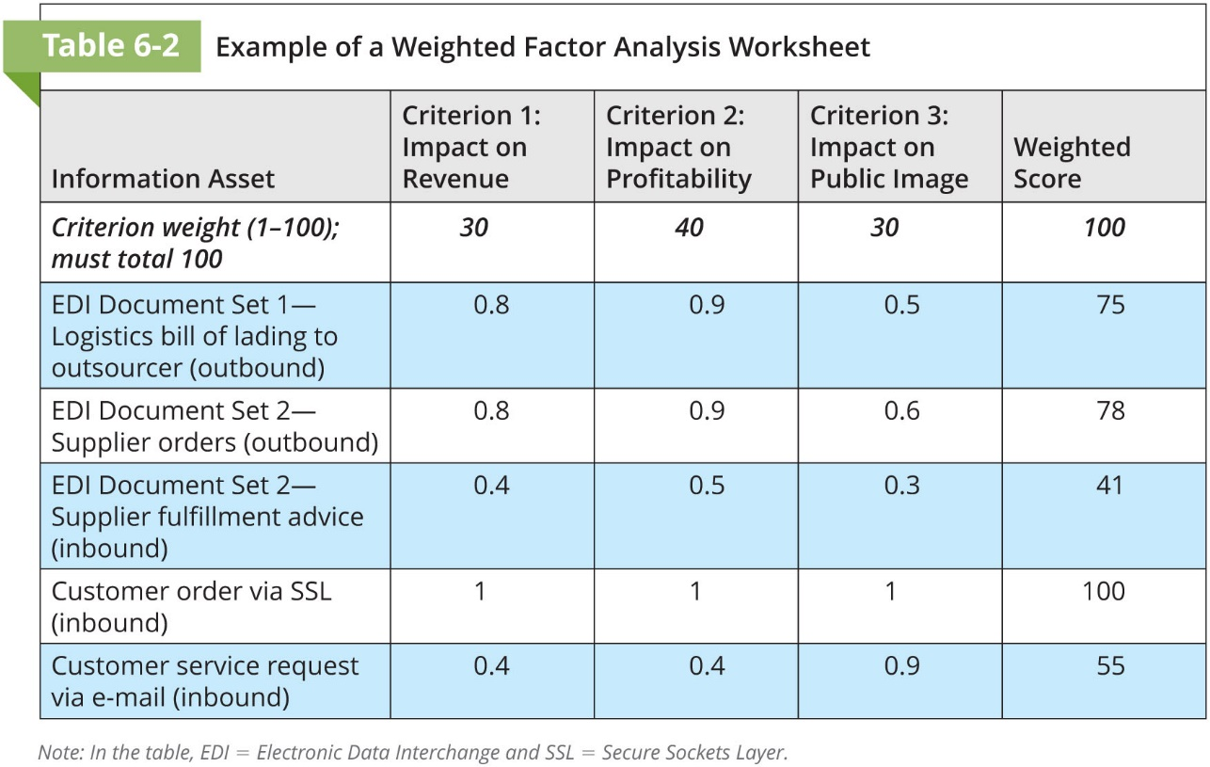

Slide 44
Threat Assessment
Armed with a properly classified inventory, you can assess potential weaknesses in each information asset—a process known as threat assessment
Any organization typically faces a wide variety of threats; if you assume that every threat can and will attack every information asset, then the project scope becomes too complex
To make the process less unwieldy, each step in the threat identification and vulnerability identification processes is managed separately and then coordinated at the end

Slide 45
Identifying Threats
Each threat presents a unique challenge to information security and must be handled with specific controls that directly address the particular threat and the threat agent’s attack strategy
Before threats can be assessed in the risk identification process, however, each threat must be further examined to determine its potential to affect the targeted information asset
In general, this process is referred to as a threat assessment

Slide 46
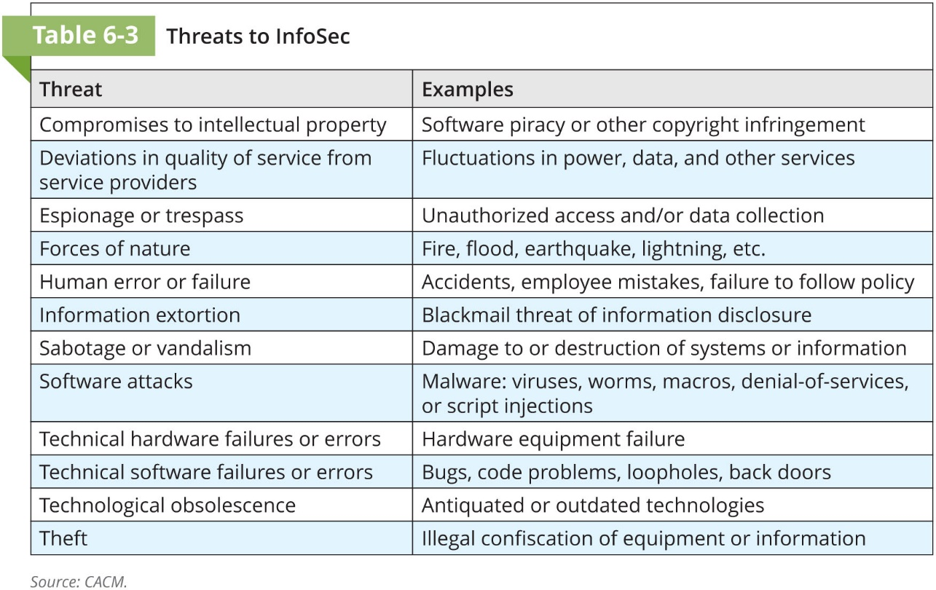

Slide 47
Assessing Threats
The following questions can help in understanding the various threats and their potential effects on an information asset
Which threats
represent an actual danger to our organization’s information?
are internal and which are external?
have the highest probability of occurrence?
have the highest probability of success?
could result in the greatest loss if successful?
are the organization least prepared to handle?
cost the most to protect against?
cost the most to recover from?

Slide 48
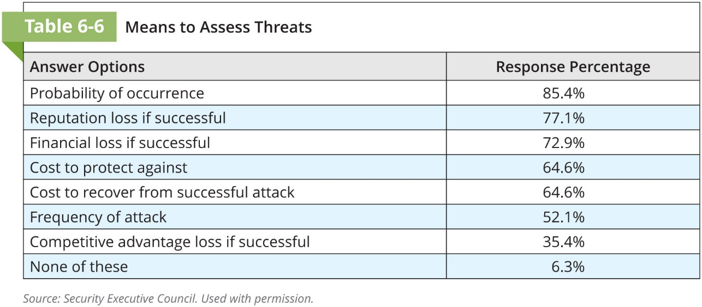

Slide 49
Prioritizing Threats
Just as it did with information assets, the organization should conduct a weighted table analysis with threats
The organization should list the categories of threats it faces, and then select categories that correspond to the questions of interest
In extreme cases, the organization may want to perform such an assessment of each threat by asset, if the severity of each threat is different depending on the nature of the information asset under evaluation

Slide 50
Vulnerability Assessment
Once the organization has identified and prioritized both its information assets and the threats facing those assets it can begin to compare information asset to threats
This review leads to the creation of a list of vulnerabilities that remain potential risks to the organization
Vulnerabilities are specific avenues that threat agents can exploit to attack an information asset
A list should be created for each information asset to document its vulnerability to each possible or likely attack

Slide 51
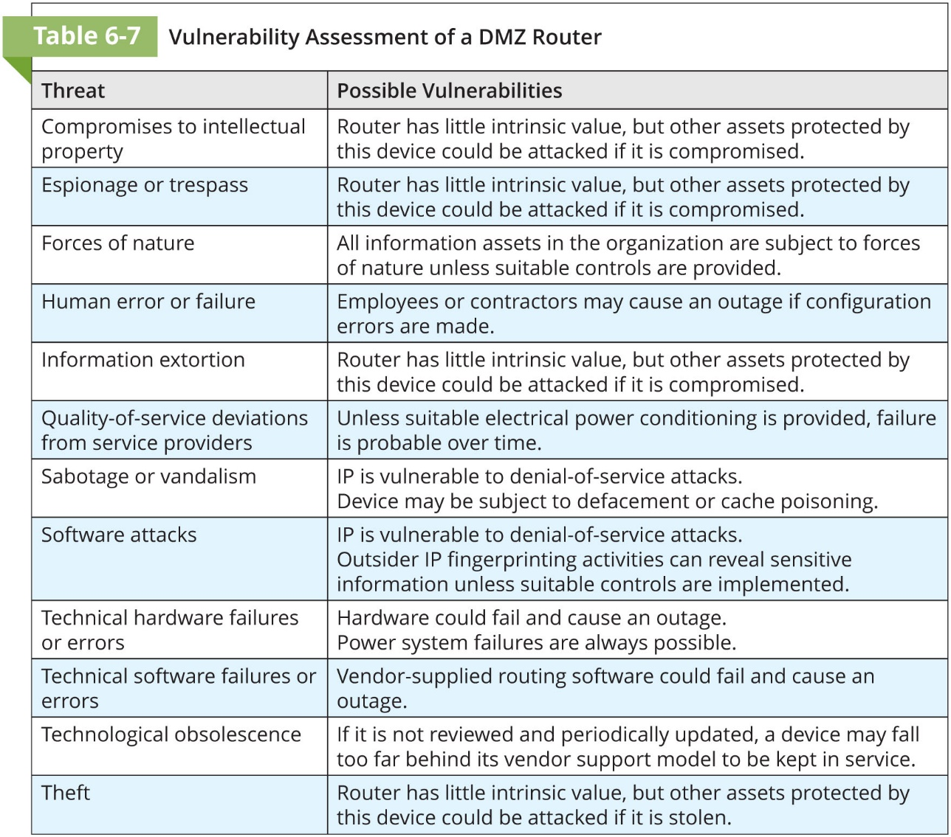

Slide 52
The TVA Worksheet
At the end of the risk identification process, an organization should have
a prioritized list of assets and
a prioritized list of threats facing those assets
The prioritized lists of assets and threats can be combined into a Threats-Vulnerabilities-Assets (TVA) worksheet, in preparation for the addition of vulnerability and control information during risk assessment
This provides a starting point for a risk assessment, along with the other documents and forms

Slide 53
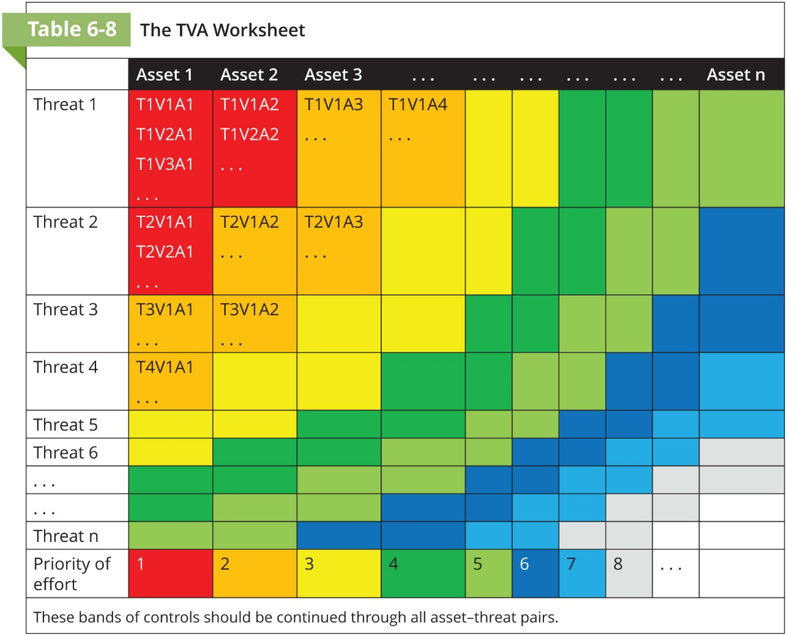

Slide 54
Risk Assessment: Risk Analysis
Chapter 06: Risk Management: Assessing Risk

Slide 55
Risk Assessment: Risk Analysis
Assessing the relative risk for each vulnerability is accomplished via a process called risk analysis
Risk analysis assigns a risk rating or score to each specific vulnerability
While this number does not mean anything in absolute terms, it enables you to gauge the relative risk associated with each vulnerable information asset, and it facilitates the creation of comparative ratings later in the risk treatment process

Slide 56
Assessing Risk
Estimating risk is not an exact science; thus some practitioners use calculated values for risk estimation, whereas others rely on broader methods of estimation
The goal is to develop a repeatable method to evaluate the relative risk of each of the vulnerabilities that have been identified and added to the list

Slide 57
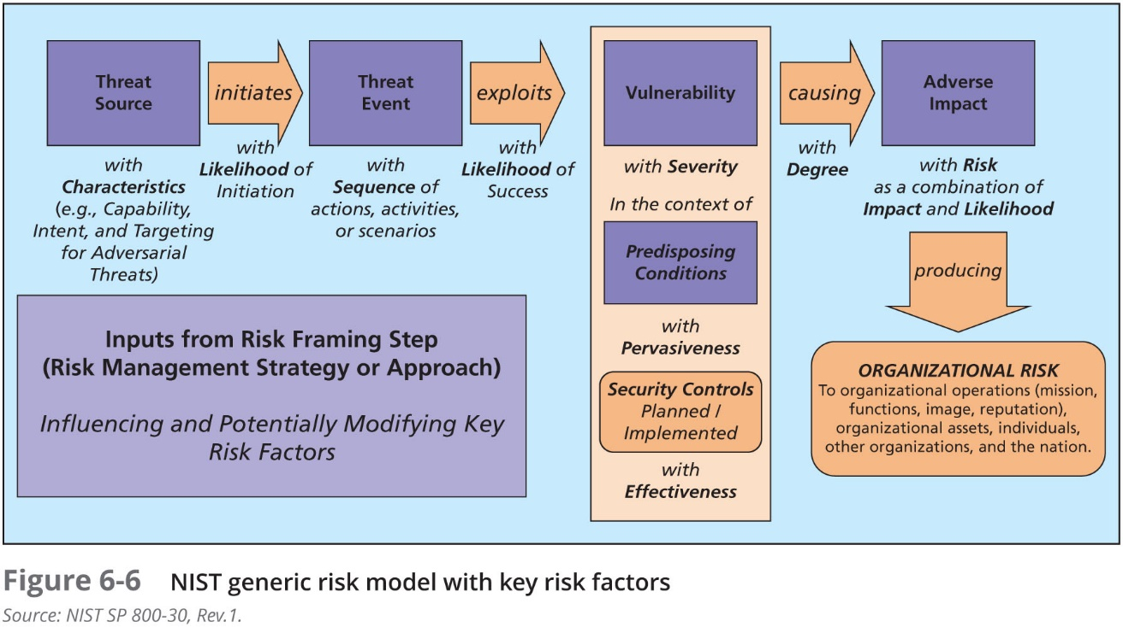

Slide 58
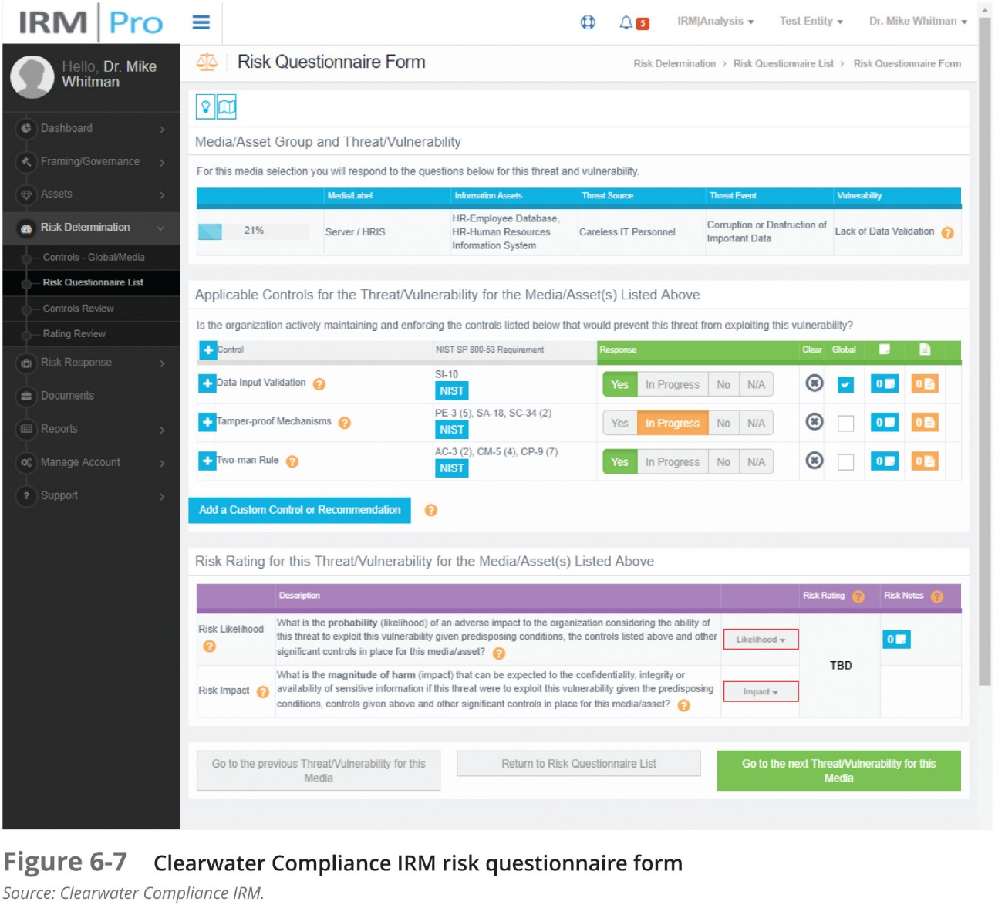

Slide 59
Mitigation of Applicable Controls
If a vulnerability is fully managed by an existing control, it can be set aside
If it is partially controlled, estimate what percentage of the vulnerability has been controlled

Slide 60
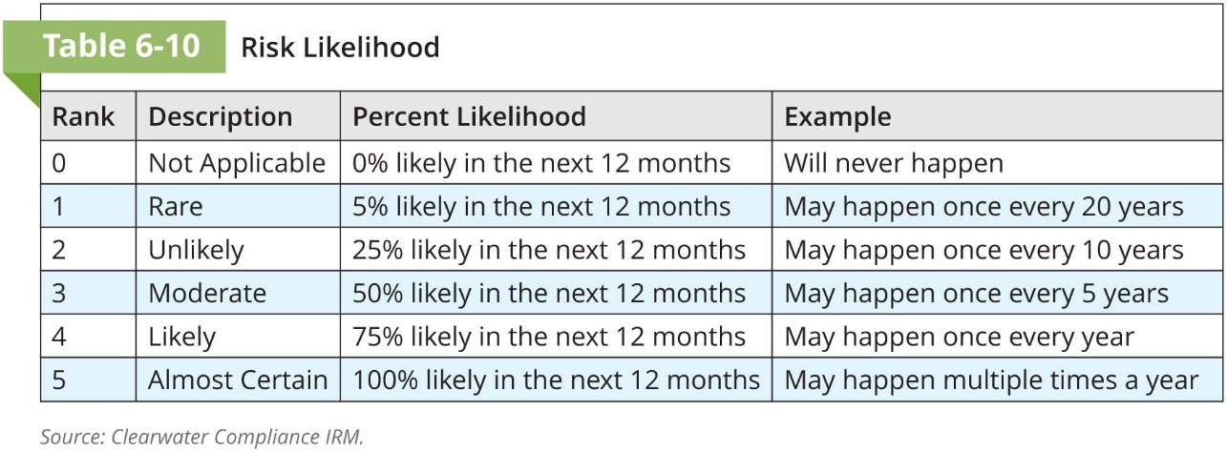
Determining the Likelihood of a Threat Event
Likelihood is the overall rating—a numerical value on a defined scale—of the probability that a specific vulnerability will be exploited
A simple method of assessing risk likelihood is to score the event on a rating scale:

Slide 61
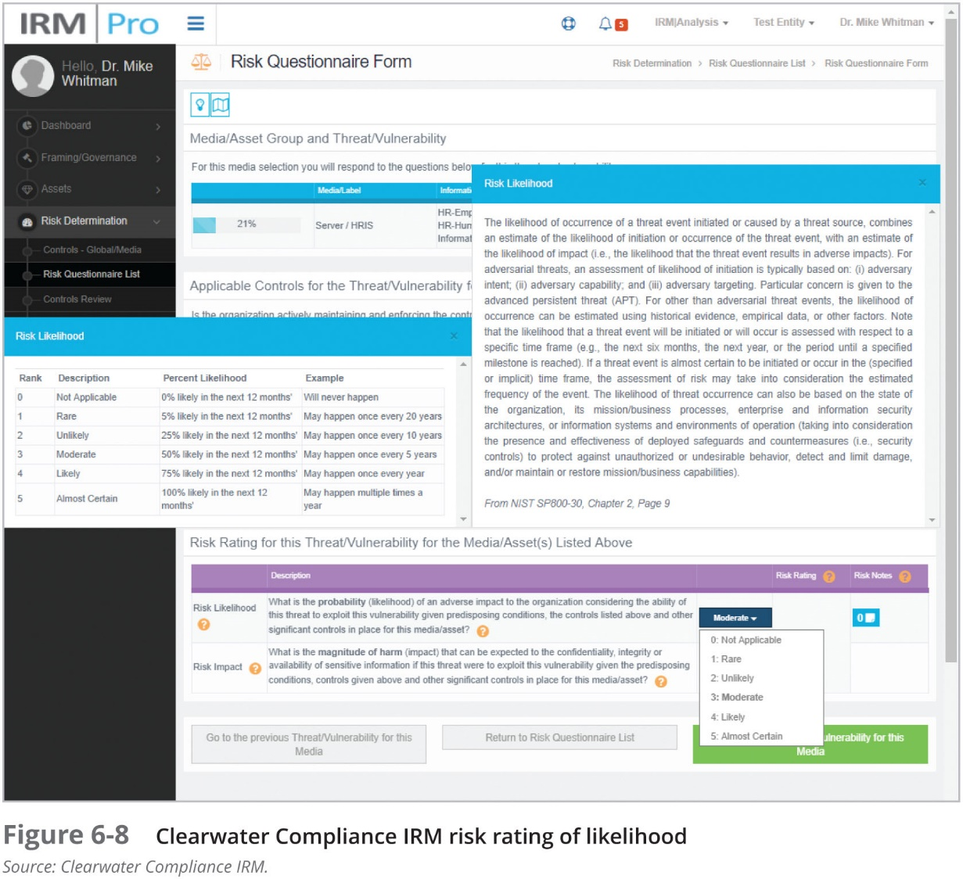

Slide 62
Assessing Potential Impact on Asset Value
Once the probability of an attack by a threat has been evaluated, the organization will typically look at the possible impact or consequences of a successful attack
The impact of an attack (most often as a loss in asset value) is of great concern to the organization in determining where to focus its protection efforts
Most commonly, organizations will create multiple scenarios to better understand the potential loss of a successful attack, using a “worst case/most likely outcome” approach
It is useful for organizations to retain this information, as it can also be used during contingency planning

Slide 63
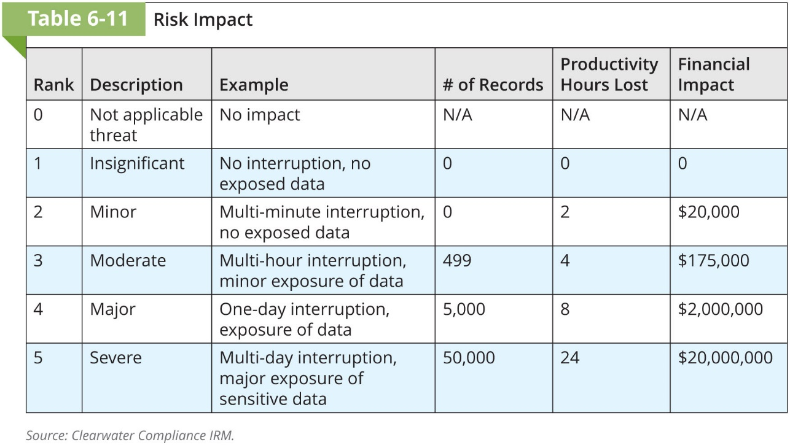

Slide 64
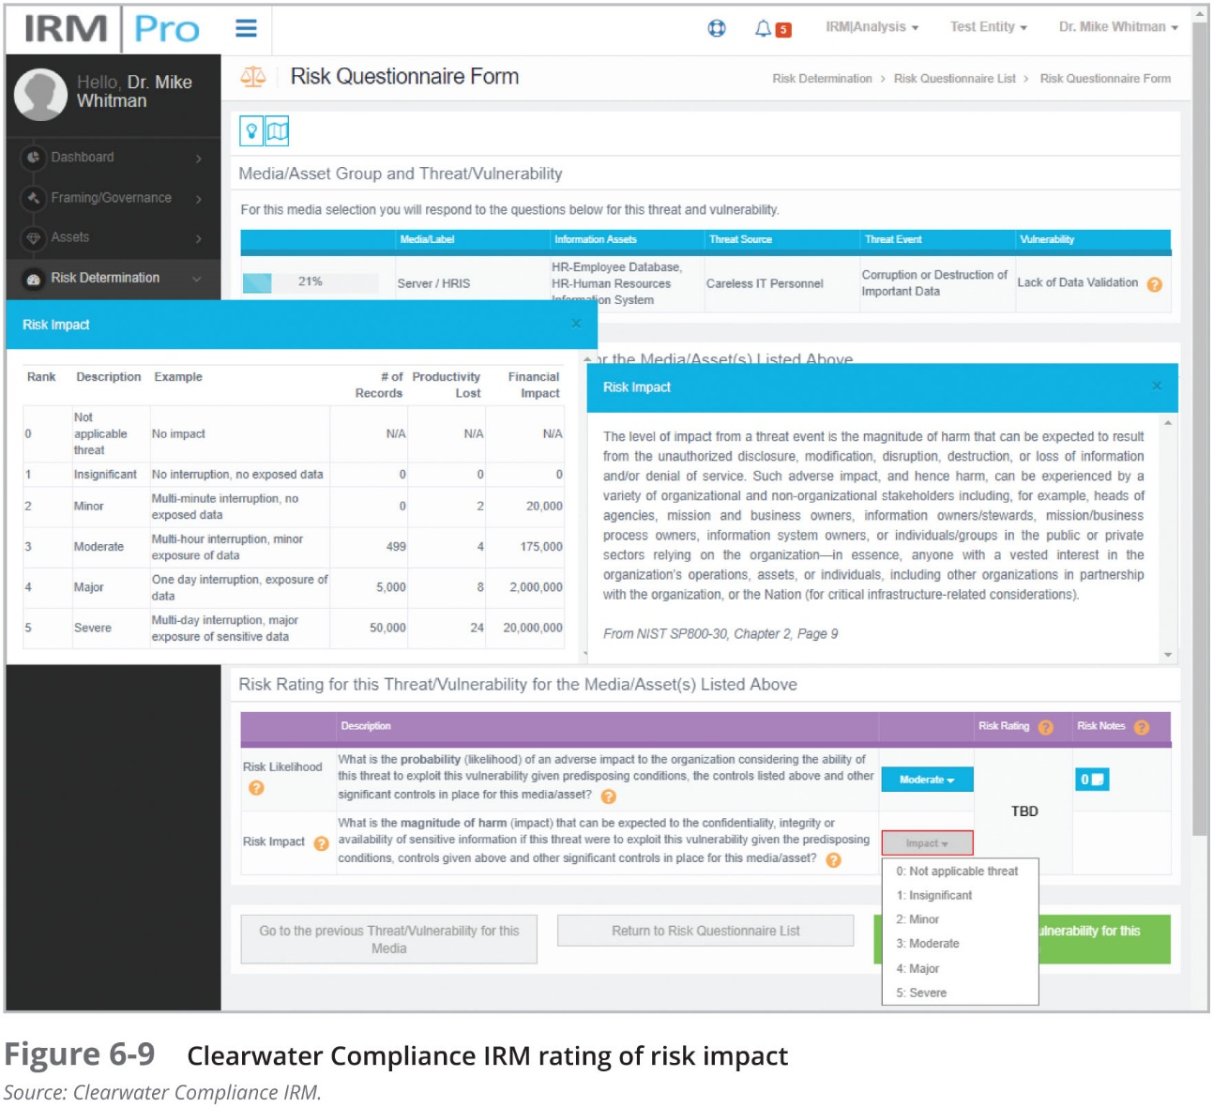

Slide 65
Aggregation
If the RM process begins to overwhelm an small/medium business, the RM team can begin merging together or aggregating groups of assets, threats, and their associated risks into more general categories
Aggregation is one tool to assist in the RM process; others include using simpler methodologies (although the method shown here is relatively simplistic) with more qualitative approaches, or purchasing applications that guide the organization through the entire process

Slide 66
Uncertainty
It is not possible to know everything about every vulnerability, such as the likelihood of an attack against an asset or how great an impact a successful attack would have on the organization
The degree to which a current control can reduce risk is also subject to estimation error
Uncertainty is an estimate made by the manager using judgment and experience

Slide 67
Risk Determination
Once the likelihood and impact are known, the organization can perform risk determination using a formula that seeks to quantify certain risk elements
In this formula, risk equals likelihood of threat event (attack) occurrence multiplied by impact (or consequence), plus or minus an element of uncertainty
Most organizations simply accept the uncertainty factor and go with a simpler formula: Likelihood × Impact

Slide 68
Risk Determination (Continued)
Information asset 1 faced with threat 1 is at risk with general vulnerability 1. The risk rating for A1V1T1 (or T1V1A1 if you prefer) has been assigned a Likelihood value of 3 and an Impact value of 5. You estimate that assumptions and data are 90 percent accurate (uncertainty of ± 10%). The resulting risk rating is 15 ± 1.5, so your risk rating range is 13.5–16.5 on a 25-point scale
Information asset 2 faced with threat 2 is at risk with general vulnerabilities 2 and 3. The risk rating for A2V2T2 has a Likelihood rating of 4 and an Impact rating of 4. The risk rating for A2V3T2 has a Likelihood rating of 3 and an Impact rating of 2. You estimate that assumptions and data are 80 percent accurate. The resulting risk rating for A2V2T2 is 16 ± 3.2 (range of 12.8–19.2). The risk rating for A2V3T2 is 6 ± 1.2 (range of 4.8–7.2)

Slide 69
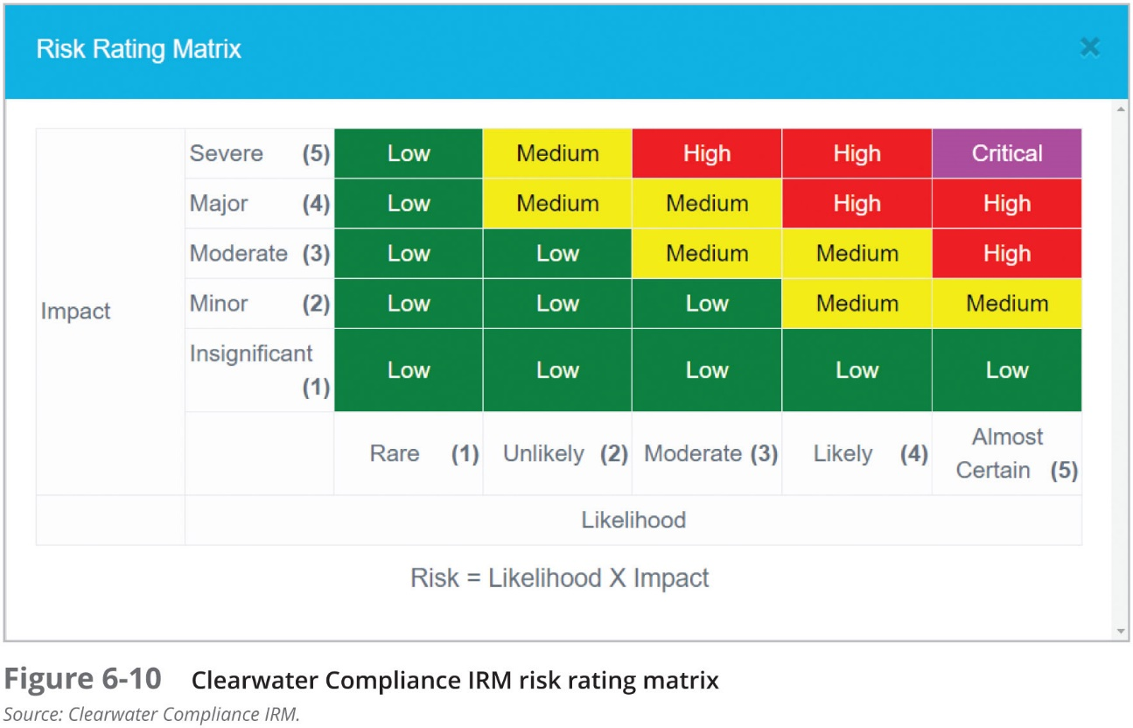

Slide 70
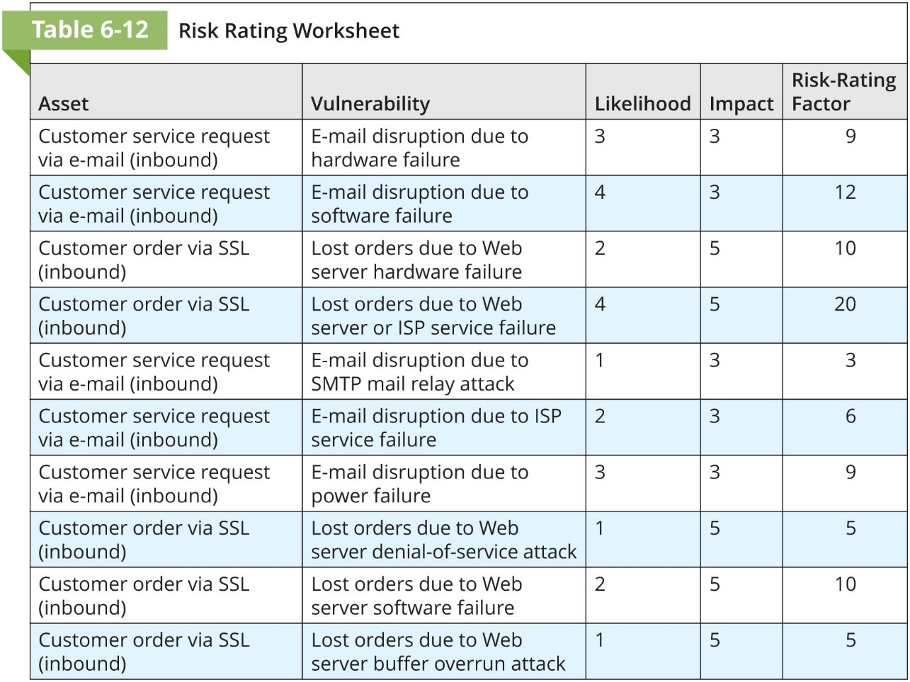

Slide 71
Risk Evaluation
Once the risk ratings are calculated for all TVA triples, the organization needs to decide whether it can live with the analyzed level of risk—in other words, the organization must determine its risk appetite
This is the risk evaluation stage
The organization must translate its risk appetite from the general statement developed by the RM framework team (and based on guidance from the governance group) to a numerical value it can compare to each analyzed risk

Slide 72
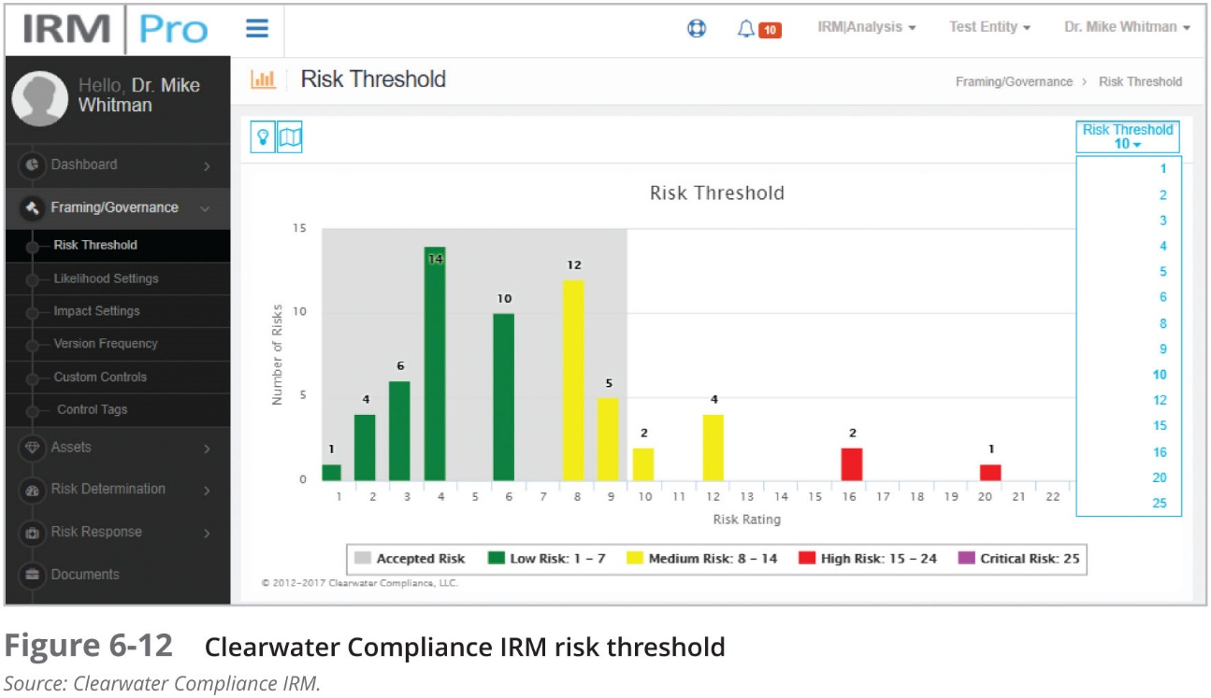

Slide 73
Documenting the Results of Risk Assessment
The efforts to compile risks into a comprehensive list allow the organization to make informed choices from the best available information
It is also of value for future iterations of the process to document the results in a reusable form

Slide 74
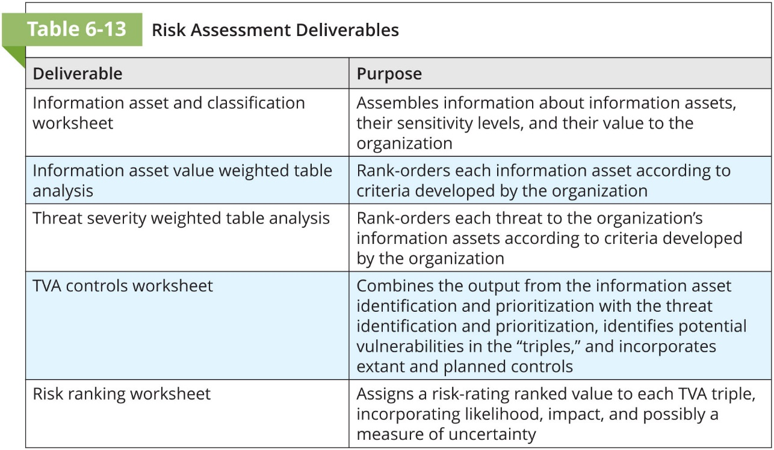

Slide 75
Evaluating Risk
Once the risk has been identified and its relative severity against the value of the information asset has been evaluated, the organization must decide whether the current level of risk is acceptable or something must be done
If the RM process team completes its analysis and shares its findings with the framework team and/or governance group, and the executive decision makers state, “We can live with that,” then the process moves on to the monitoring and review function, where the organization keeps an eye on assets, threats, and vulnerabilities for a trigger to restart the RM process anew.
If the decision makers indicate that they are not comfortable with the current level of risk, then the next stage of the RM process proceeds: risk treatment

Slide 76
Evaluating Risk (Continued)
Another factor that makes this process even more challenging is that the solution for one information asset may positively or negatively affect the level of risk in other information assets
The bottom line is that once the risk is known, it requires extensive deliberation and understanding before the “yea or nay” decision is made
Another step performed during risk evaluation is the prioritization of effort for the treatment of risk, which occurs in the next step of the RM process

Slide 77
Risk Treatment/Risk Control
Risk treatment, also known as risk control, is the process of doing something about risk once the organization has identified risk, assessed it, evaluated it, and then determined that the current level of remaining risk—the residual risk—is unacceptable
A variety of options are open to organizations, including removing the information asset from harm’s way, modifying how it is currently protected, and passing the responsibility for its protection or replacement to third parties

Slide 78
Process Communications, Monitoring, and Review
As the process team works through the various RM activities, it needs to continually provide feedback to the framework team about the relative success and challenges of its RM activities
This feedback is used to improve not only the process, but the framework as well
It is critical that the process team have one or more individuals designated to collect and provide this feedback as well as a formal mechanism to submit it to the framework team
These process communications facilitate the actions in the process monitoring (for feedback) and review (for assessment)

Slide 79
Chapter Summary
Risk management examines and documents an organization’s information assets
Management is responsible for identifying and controlling the risks that an organization encounters. In the modern organization, the InfoSec group often plays a leadership role in risk management
A key component of a risk management strategy is the identification, classification, and prioritization of the organization’s information assets
Assessment is the identification of assets, including all the elements of an organization’s system: people, procedures, data, software, hardware, and networking elements

Slide 80
Chapter Summary
The human resources, documentation, and data information assets of an organization are not as easily identified and documented as tangible assets, such as hardware and software. These more elusive assets should be identified and described using knowledge, experience, and judgment
You can use the answers to the following questions to develop weighting criteria for information assets:
Which information asset is the most critical to the success of the organization?
Which information asset generates the most revenue?
Which information asset generates the highest profitability?
Which information asset is the most expensive to replace?
Which information asset is the most expensive to protect?
Which information asset’s loss or compromise would be the most embarrassing or cause the greatest liability?

Slide 81
Summary
After identifying and performing a preliminary classification of information assets, the threats facing an organization should be examined. There are 12 general categories of threats to InfoSec
Each threat must be examined during a threat assessment process that addresses the following questions: Which of these threats exist in this organization’s environment? Which are the most dangerous to the organization’s information? Which require the greatest expenditure for recovery? Which require the greatest expenditure for protection?
Each information asset is evaluated for each threat it faces; the resulting information is used to create a list of the vulnerabilities that pose risks to the organization. This process results in an information asset and vulnerability list, which serves as the starting point for risk assessment

Slide 82
Summary (Continued)
A TVA worksheet lists the assets in priority order along one axis, and the threats in priority order along the other axis. The resulting grid provides a convenient method of examining the “exposure” of assets, allowing a simple vulnerability assessment
The goal of risk assessment is the assignment of a risk rating or score that represents the relative risk for a specific vulnerability of a specific information asset
If any specific vulnerability is completely managed by an existing control, it no longer needs to be considered for additional controls

Slide 83
Summary (Continued)
The risk identification process should designate what function the resulting reports serve, who is responsible for preparing them, and who reviews them. The TVA worksheet and the ranked vulnerability risk worksheet are the initial working documents for the next step in the risk management process: assessing and controlling risk

